Slide 1
Chapter 4 System Requirements

Slide 2
Lesson Objectives
Differentiate between User requirements and System requirements
Differentiate between Functional and Non-functional Requirement
Explain why natural language specification is not desirable
Understand how requirements may be organised in a Software Requirements Specification (SRS)

Slide 3

User Requirements vs. System Requirements

Slide 4

User Requirements vs. System Requirements
Requirements for a software system set out what the system should do and define constraints on its operation and implementation.
Two different types of requirements:
User requirements
System requirements

Slide 5

User Requirements
High level abstract requirement
Statements with natural language with diagrams & tables
For user & people who procure system

Slide 6
User Requirements
User requirements are high-level abstract requirements. They are intended for use by people involved in using and procuring the system.
User requirements are statements in natural language, with easy-to-understand diagrams and tables, of what services the system is expected to provide and the constraints under which it must operate.

Slide 7

System Requirements
Precious & Detail Description
Extended Version of User Requirement
Structured form of natural language supported by system models & tables
During requirement analysis

Slide 8
System Requirements
Starting point for design
a.k.a. Functional Specifications
Contract between developer & customer

Slide 9
System Requirements
System requirements are more precise and detail descriptions of the system’s functions, services and operational constraints.
They may be written in structured form of natural language supported by system models and tables

Slide 10
System Requirements
System requirements are also used by software designers as the starting point for the system design, so they are sometimes called “functional specifications”.
They may be the basis of a contract between the system developer and customer. Therefore should be complete and consistent specification of the whole system.

Slide 11
User Requirements vs. System Requirements
Readers of User Requirements
Client Managers
Contractor Managers
System End-User
Client Engineers
System Architects
Readers of System Requirements
Software Developers
System End-User
Client Engineers
System Architects

Slide 12
User Requirements vs. System Requirements
Examples:
User Requirement
1. The software must provide a means of representing and accessing external files created by other tools
System Requirement
1.1 The user should be provided with facilities to define the type of external files
1.2 Each external file type may be represented as a specific icon on the user’s display.
1.3 Facilities should be provided for the icon representing an external file type to be define by the user

Slide 13
User Requirements vs. System Requirements
Examples:
User Requirement
1. LIBSYS shall keep track of all data required by copyright licensing agencies in the UK and elsewhere
System Requirement
1.1 On making a request for a document from LIBSYS, the requestor shall be presented with a form that records details of the user and the request made.
1.2 LIBSYS request forms shall be stored on the system for five years from that data of the request.
1.3 All LIBSYS request forms must be indexed by user, by name of the material requested and by the supplier of the request.
1.4 LIBSYS shall maintain a log of all requests that have been made to the system.
1.5 For material where authors’ lending rights apply, loan details shall be sent monthly to copyright licensing agencies that have registered with LIBSYS

Slide 14
User Requirements vs. System Requirements
What is the main difference between user requirement and system requirement?
System requirement is more precise and detail than user requirement as they are intended to communicate information about the system to different types of readers.

Slide 15
Exercise – Past Year Question
Prepare the user requirement and system requirement for the Online Purchase Concert Ticket function for an online system which allows online users to check seat availability, concert details, purchase tickets etc.
Marking Criteria | Marks Allocation
User Requirement | 2
System Requirement | 7

Slide 16
Exercise – Past Year Question
Online Purchase Concert Ticket
User Requirement
1. The system must provide a facility which allows the online users to check on concert details, seat availability and purchase tickets

Slide 17
Exercise – Past Year Question
Online Purchase Concert Ticket
System Requirement
1.1 The system allows the online users to view concert’s details
1.2 The users can check the seat availability for the concert they are interested in
1.3 The users can select the seating position available and make a purchase for the ticket(s)
1.4 The system will calculate the charges once the user confirmed the transaction
1.5 The system will also check on the payment details such credit card number and etc.
1.6 If invalid payment details, the system will show message
1.7 If valid, the system will proceed transaction and update the seat(s) to not available
1.8 The system will generate on-line receipt

Slide 18

Functional and Non-Functional Requirements

Slide 19
Functional & Non-Functional Requirements
Software System Requirements
Functional Requirements
Non-Functional Requirements

Slide 20




Functional Requirements
Services
How System Behave to situation
How System React to input
What system should not do

Slide 21
Functional Requirements
These are statement of services the system should provide, how the system should react to particular inputs and how the system should behave in particular situation. In some cases, the functional requirements may also explicitly state what the system should not do.

Slide 22
Functional Requirements
Examples of functional requirements of a university library system called LIBSYS:
1.1 The user shall be able to search either all of the initial set of databases or select a subset from it.
1.2 The system shall provide appropriate viewers for the user to read documents in the document store.

Slide 23
Functional Requirements
HR System – Employee Self Service Sub-system:
1.0 Basic Personal Tasks
1.1 Employees can perform routine HR administration tasks such as changing name, address, home / work telephone numbers, emergency contacts, next of kin, marriage, births or adoption details
1.2 Employees can upload common information to existing databases e.g. telephone directories and organization charts
1.3 Employees can view employees own employment history i.e. promotions, dates, appraisal reviews, training records
1.4 Employees can view conditions of employment, HR policies, procedures, information packs, benefits details

Slide 24
Functional Requirements
HR System – Employee Self Service Sub-system:
2.0 Time and Attendance Tasks
2.1 Employees can enter time sheets, plus with workflow, automatically submit request to manager for approval and once approved, automatically posted to payroll.
2.2 Employees can manage absences from work. Enter absence details.

Slide 25

Non Functional Requirements
Constraints

Slide 26
Non Functional Requirements
Product Requirements
External Requirements
Organizational Requirements

Slide 27
Non Functional Requirements
Non-Functional Requirements
Product Requirements
Usability
Performance
Space
Reliability
Portability
Notes:
Performance is an indication of the responsiveness of a system to execute any action within a given time interval. It can be measured in terms of latency or throughput. Latency is the time taken to respond to any event. Throughput is the number of events that take place within a given amount of time.
Interoperability describes the extent to which systems and devices can exchange data, and interpret that shared data. For two systems to be interoperable, they must be able to exchange data and subsequently present that data such that it can be understood by a user.

Slide 28
Non Functional Requirements
Non-Functional Requirements
Product Requirements
Process/Organizational Requirements
Usability
Delivery
Efficiency
Implementation
Performance
Standards
Space
Reliability
Portability
Notes:
Interoperability describes the extent to which systems and devices can exchange data, and interpret that shared data. For two systems to be interoperable, they must be able to exchange data and subsequently present that data such that it can be understood by a user.

Slide 29
Non Functional Requirements
Non-Functional Requirements
Product Requirements
Process/Organizational Requirements
External Requirements
Usability
Delivery
Interoperability
Efficiency
Implementation
Ethical
Performance
Standards
Legislative
Space
Privacy
Reliability
Safety
Portability
Notes:
Interoperability describes the extent to which systems and devices can exchange data, and interpret that shared data. For two systems to be interoperable, they must be able to exchange data and subsequently present that data such that it can be understood by a user.

Slide 30
Non Functional Requirements
Product Requirements
These are requirements which result from the need for the delivered product to behave in a particular way.
Organisational Requirements
These are requirements which are a consequence of organisational policies and procedures.
External Requirements
This broad heading covers all requirements which arise from factors external to the system and its development process.

Slide 31
Non Functional Requirements
Example
Product requirement
8.1 The user interface for LIBSYS shall be implemented as simple HTML without frames or Java applets.
Organizational requirement
9.3.2 The system development process and deliverable documents shall conform to the process and deliverables defined in XYZ-ST95.

Slide 32
Non Functional Requirements
Example
External requirement
10.6 The system shall not disclose any personal information about system users apart from their name and library reference number to library staff who use the system.

Slide 33
Exercise – Past Year Question
Q1: Prepare the user requirement and system requirement for the Online Purchase Concert Ticket function for an online system which allows online users to check seat availability, concert details, purchase tickets etc.
Q2: Give 2 Functional and 2 Non-Functional Requirement for the above online system

Slide 34

Problems with Natural Language

Slide 35



Natural Language Problems
Lack of clarity
Ambiguity?
Precise?
Wordy
Difficult to read

Slide 36
Natural Language Problems
Requirement confusion
Lack of clarity
Functional vs. non-functional?
System goals?
Design info

Slide 37
Natural Language Problems
Requirement confusion
Lack of clarity
Amalgamation

Slide 38
Natural Language Problems
3 types of major problem with user requirements written in natural language: -
Lack of clarity : difficult to use language in a precise & unambiguous way without making the document wordy & difficult to read
Requirements confusion : functional, non-functional requirements, system goals, design info may not be clearly distinguished
Requirements amalgamation : several requirements expressed as a single requirement

Slide 39
Natural Language Problems - Example
A user requirement for accounting system in LIBSYS.
4.5 LIBSYS shall provide a financial accounting system that maintains records of all payments made by users of the system. System managers may configure this system so that regular users may receive discounted rates.
Discount rate configuration
Payment Record Maintenance:
Add, Edit, Delete

Slide 40



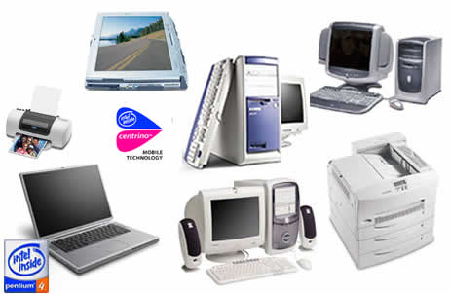

Natural Language Problems
Reasons why NL is not good
1. Understanding of SAME word for SAME concept
Tool

Slide 41

Natural Language Problems
Reasons why NL is not good
2. Natural language is OVER FLEXIBLE
Same thing can be said in many different ways

Slide 42

Natural Language Problems
Reasons why NL is not good
3. No clear partitioning
Diagrams are better to scope/represent requirements

Slide 43
Natural Language Problems
Reasons why natural language system requirements specification is not good:
Natural language understanding relies on the specification readers and writers using the same words for the same concept.
A natural language requirements specification is over-flexible
Requirements are not partitioned effectively by the language itself

Slide 44
?
How do you construct System Requirement Specification (SRS)?

Slide 45
Notations for System Requirements Specification (SRS)
Solution?
Structured natural language
Design description language
Graphical notations
Mathematical specifications

Slide 46
Notations for System Requirements Specification (SRS)
Decision Table
Solution?
Structured natural language
Design description language
Graphical notations
Mathematical specifications
Template/Table for sys input, process, output (like data dictionary)

Slide 47
Notations for System Requirements Specification (SRS)
Solution?
Structured natural language
Design description language
Graphical notations
Mathematical specifications
Like PL: e.g. PSL/PSA, RSL

Slide 48
Notations for System Requirements Specification (SRS)
Solution?
Structured natural language
Design description language
Graphical notations
Mathematical specifications
DFD
Sequence Diagrams

Slide 49
Notations for System Requirements Specification (SRS)
Solution?
Structured natural language
Design description language
Graphical notations
Mathematical specifications
Finite-state machine/set
Z-specification

Slide 50
Notations for System Requirements Specification (SRS)
Solution?
Structured natural language – Decision tables, template/ table to specify system input, process, output, etc. (like a data dictionary)
Design description language – uses a language like programming language E.g. PSL/PSA, RSL with special terminologies like programming language
Graphical notations – DFD, flowchart, use-case diagrams, sequence diagrams, activity diagrams etc.
Mathematical specifications – based on mathematical concepts such as finite-state machines or sets. Formal specification like Z-specification

Slide 51

Software Requirements Document
Software Requirement Specification (SRS)

Slide 52

Software Requirements Document
Official statement
User Requirements
Sys. Requirements

Slide 53
Software Requirements Document
System requirements are expressed in a software requirements document.
The software requirements document (sometimes known as SRS - software requirements specification) is the official statement of what is required of the system developer.
It should include both:
the user requirements for a system and
a detailed specification of the system requirements

Slide 54
Software Requirements Document
Specify WHAT without HOW
Complete & consistent
No conflict

Slide 55
Software Requirements Document
This document is not a design document. It should set out what the system should do without specifying how it should be done.
In principle, the requirements set out in this document ought to be complete and consistent.
All system functions should be specified and requirements should not conflict.

Slide 56




Software Requirements Document
System Customers
System Engineers
System Test Engineers
Project Manager
SRS users
System Maintenance Engineers

Slide 57
Software Requirements Document
The requirements document has a diverse set of users:
i) System customers
Specify the requirements and read them to check that they meet their needs. They specify changes to the requirements
ii) (Project) Managers
Use the requirements document to plan a bid for the system and to plan the system development process

Slide 58
Software Requirements Document
The requirements document has a diverse set of users:
iii) System engineers
Use the requirements to understand what system is to be developed
iv) System test engineers
Use the requirements to develop validation tests for the system
v) System maintenance engineers
Use the requirements to help understand the system and the relationships between its parts

Slide 59

Software Requirements Document
The structure of SRS:
Preface
Introduction
Purpose
Scope
Overview
Business Context

Slide 60
Software Requirements Document
The structure of SRS:
Preface
Introduction
Glossary
Definition of terms

Slide 61
Software Requirements Document
The structure of SRS:
Preface
Introduction
Glossary
User requirements definition
General

Slide 62
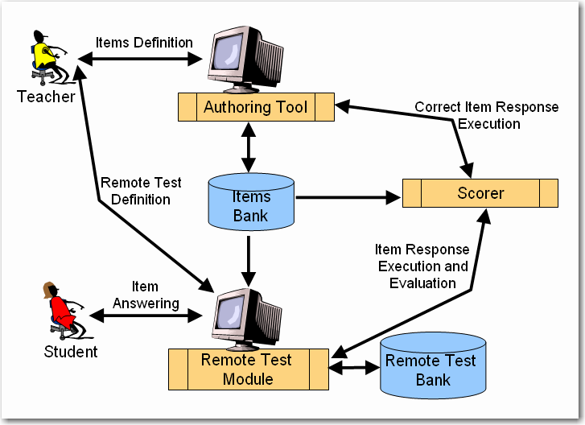
Software Requirements Document
The structure of SRS:
Preface
Introduction
Glossary
User requirements definition
System architecture
Chapter 6

Slide 63
Software Requirements Document
The structure of SRS:
Preface
Introduction
Glossary
User requirements definition
System architecture
System requirements specification
Functional
Non-Functional
Interface
Performance

Slide 64
Software Requirements Document
The structure of SRS:
Preface
Introduction
Glossary
User requirements definition
System architecture
System requirements specification
System models
Chapter 6

Slide 65
Software Requirements Document
The structure of SRS:
Preface
Introduction
Glossary
User requirements definition
System architecture
System requirements specification
System models
System evolution
Version （Chp 11)

Slide 66
Software Requirements Document
The structure of SRS:
Preface
Introduction
Glossary
User requirements definition
System architecture
System requirements specification
System models
System evolution
Appendices
References (supporting documents)

Slide 67
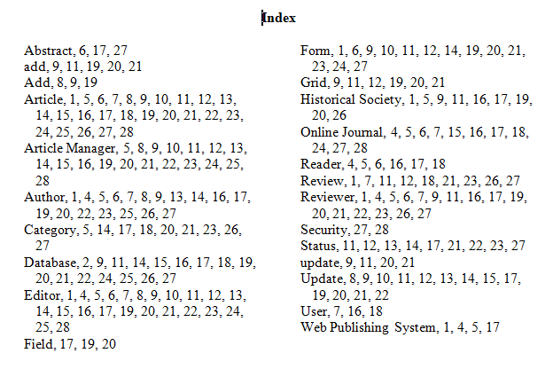
Software Requirements Document
The structure of SRS:
Preface
Introduction
Glossary
User requirements definition
System architecture
System requirements specification
System models
System evolution
Appendices
Index

Slide 68
Software Requirements Document
The structure of SRS:
Separate chapter or appendices:
Hardware
Database requirements

Slide 69
Software Requirements Document
The structure of SRS:
Preface
Introduction
Glossary
User requirements definition
System architecture
System requirements specification
System models
System evolution
Appendices
Index

Slide 70
Software Requirements Document
Example of TARUC FYP’s SRS
Content of System Requirements
General Description
External Interface Requirements
Non-functional Requirements
Functional Requirements
Other Requirements
(Please refer to Final Year Project – SRS guidelines)

Slide 71
Thanks!
Any questions ?

